Slide 1
CSS-1

Slide 2
CSS
What is CSS?
  CSS stands for Cascading Style Sheets
  CSS defines how HTML elements are to be displayed
  Styles were added to HTML 4.0 to solve a problem
  CSS saves a lot of work
  External Style Sheets are stored in CSS files

Slide 3
CSS
What is CSS?
  Cascading Style Sheets (CSS) – is a rule based language that applies styling to your HTML elements.
  You write CSS rules in elements, and modify properties of those elements such as color, background color, width, border thickness, font size, etc.

Slide 4
CSS
Why CSS?
  HTML was NEVER intended to contain tags for formatting a document.
  HTML was intended to define the content of a document, like:
  <h1>This is a heading</h1> & <p>This is a paragraph.</p>
  When tags like <font>, and color attributes were added to the HTML 3.2 specification, it started a nightmare for web developers.
  Development of large web sites, where fonts and color information were added to every single page, became a long and expensive process.

Slide 5
CSS
Why CSS?
  To solve this problem, the World Wide Web Consortium (W3C) created CSS to make web page designing more dynamic & easy.
  From HTML 4.0, all formatting could (and should!) be removed from the HTML document, and stored in a separate CSS file.
  CSS Saves a Lot of Work!
  The style definitions are normally saved in external .css files.
  With an external style sheet file, you can change the look of an entire Web site by making changes in just one file!

Slide 6
CSS
How CSS?
Three Ways to Insert CSS
  External style sheet
  Internal style sheet
  Inline style

Slide 7
CSS
How CSS? (CONTD…)
  External style sheet:
  With an external style sheet, you can change the look of an entire website by changing just one file!
  Each page must include a reference to the external style sheet file inside the <link> element. The <link> element goes inside the head section:
  <head>
  <link rel="stylesheet" type="text/css“ href=“demo.css">
  </head>
  demo.css

Slide 8
CSS
How CSS? (CONTD…)
  External style sheet:
    An external style sheet can be written in any text editor.
    The file should not contain any html tags. The style sheet file must be saved with a .css extension.
    An example of a style sheet file called “demo.css", is shown in next slide:

Slide 9
CSS
How CSS? (CONTD…)
  External style sheet:
  demo.css
  body {
  background-color: lightblue;
  }
  h1 {
  color: navy;
  margin-left: 20px;
  }

Slide 10
CSS
How CSS? (CONTD…)
  Internal style sheet:
    An internal style sheet may be used if one single page has a unique style.
    Internal styles are defined within the <style> element, inside the head section of an HTML page:
  Eg. Internal Style sheet

Slide 11
CSS
How CSS? (CONTD…)
Eg. Inline Styles
  Inline styles
    An inline style may be used to apply a unique style for a single element.
    An inline style loses many of the advantages of a style sheet (by mixing content with presentation). Use this method sparingly!
    To use inline styles, add the style attribute to the relevant tag. The style attribute can contain any CSS property. The example shows how to change the color and the left margin of a <h1> element:

Slide 12
CSS
How CSS? (CONTD…)
Defining multiple styles….

Slide 13
CSS Syntax
A CSS rule set consists of a selector and a declaration block:
The selector points to the HTML element you want to style.
The declaration block contains one or more declarations separated by semicolons.
Each declaration includes a property name and a value, separated by a colon.
Eg.-1 p {color:red; text-align:center;}
Selector
Declaration

Slide 14
CSS comments
Comments are used to explain your code, and may help you when you edit the source code on a later stage.
Comments are ignored by browsers.
A CSS comment starts with /* and ends with */.
Comments can also span multiple lines:
E.g-2:

Slide 15
CSS Font Properties:
CSS font properties define the font family, boldness, size, and the style of a text.
In CSS, there are two types of font family names:
  generic family - a group of font families with a similar look (like "Serif" or "Monospace")
  font family - a specific font family (like "Times New Roman" or "Arial")
Syntax: font-size:250%; font: arial, sans-serif;
font:bold 30px Lucida Console, Monospace;

Slide 16
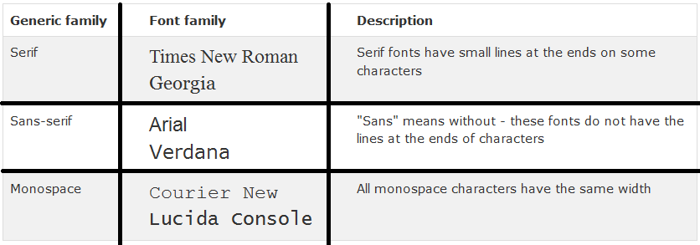

CSS Font Properties: (contd…)

Slide 17
Font Properties: (contd…)
Font Size
  The font-size property sets the size of the text.
  Being able to manage the text size is important in web design. However, you should not use font size adjustments to make paragraphs look like headings, or headings look like paragraphs.
  Always use the proper HTML tags, like <h1> - <h6> for headings and <p> for paragraphs.

Slide 18
Font Properties: (contd…)
Font Size
  The font-size value can be an absolute, or relative size.
  Absolute size:
  Sets the text to a specified size
  Does not allow a user to change the text size in all browsers (bad for accessibility reasons)
  Absolute size is useful when the physical size of the output is known
  Relative size:
  Sets the size relative to surrounding elements

Slide 19
Font Properties: (contd…)
Examples:
Eg.-3 Set Font Size With Pixels
Eg.-4 Set Font Size With em

Slide 20
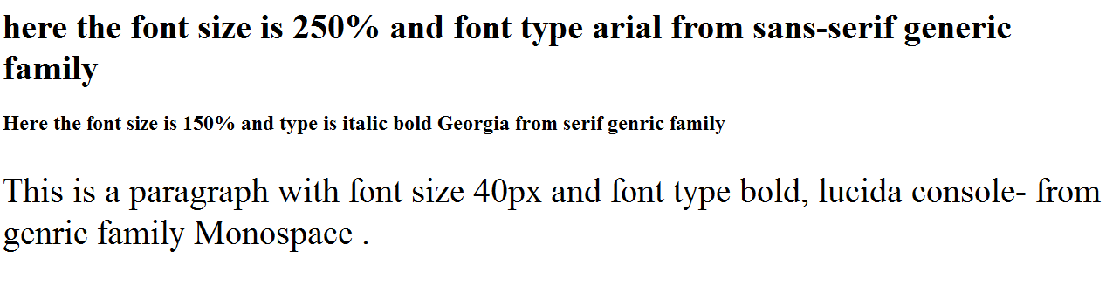
Classroom Activity:
[1]Define a CSS for getting the output in an html page as mentioned below:
Classroom Activity Example
[2] Distinguish em, %, px in context with display of fonts in browser.

Slide 21
CSS Selectors:
CSS selectors allow you to select and manipulate HTML elements.
CSS selectors are used to "find" (or select) HTML elements based on their id, class, type, attribute, and more.
The element selector
  p { color:yellow; text-align : center;}
The id Selector
  #main { color:yellow; text-align : center; }
  Do NOT start an ID name with a number!

Slide 22
CSS Selectors: (contd…)
The id Selector
The id selector uses the id attribute of an HTML element to select a specific element.
An id should be unique within a page, so the id selector is used if you want to select a single, unique element.
To select an element with a specific id, write a hash character, followed by the id of the element.
This style rule will be applied to the HTML element with id="para1": in eg.5
Eg.-5 css id selector

Slide 23
CSS Selectors: (contd…)
The class Selector
The class selector selects elements with a specific class attribute.
To select elements with a specific class, write a period character, followed by the name of the class:
In the example below, all HTML elements with class="center" will be center-aligned:
Eg.-6 css class selector

Slide 24
CSS Selectors: (contd…)
The class Selector
You can also specify that only specific HTML elements should be affected by a class.
In the example below, all <p> elements with class="center" will be center-aligned:
Eg.-7 css class selector with specific element affected

Slide 25
CSS Selectors: (contd…)
Grouping the selectors
If you have elements with the same style definitions, you can group the selectors, to minimize the code.
To group selectors, separate each selector with a comma.
Eg.8 Grouping the selectors

Slide 26
CSS Selectors: (contd…)
Grouping the selectors
If you have elements with the same style definitions, you can group the selectors, to minimize the code.
To group selectors, separate each selector with a comma.
Eg.8 Grouping the selectors

